Slide 1
Definition
A Minimum Spanning Tree (MST) is a subgraph of an undirected graph such that the subgraph spans (includes) all nodes, is connected, is acyclic, and has minimum total edge weight

Slide 2
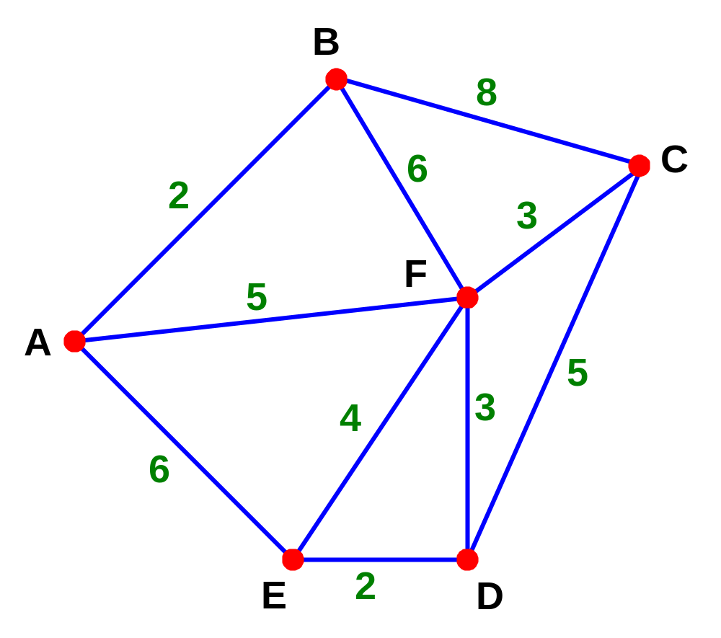
A tree is a connected graph of some vertices which contains no cycles

Slide 3
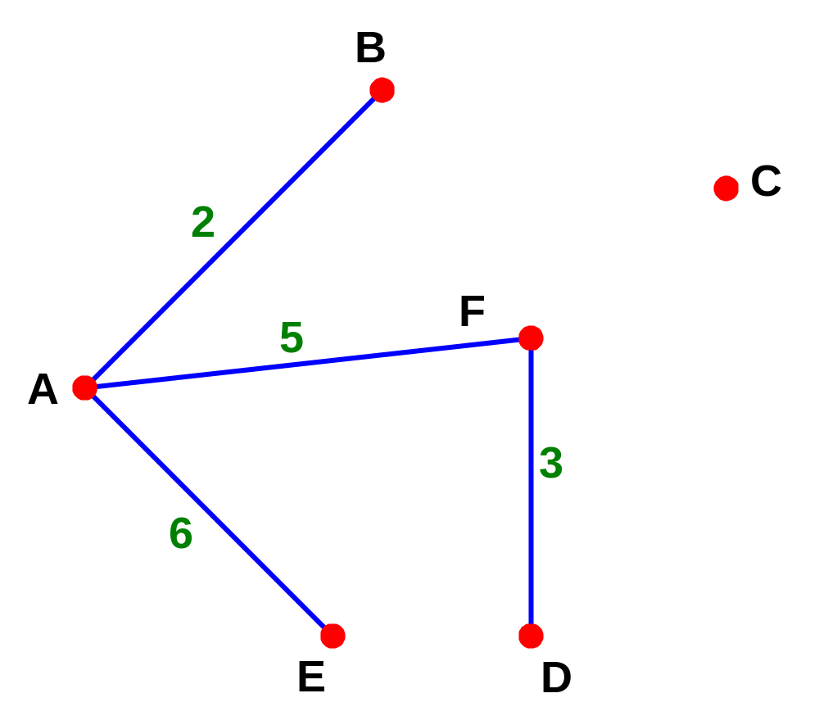
A tree is a connected graph of some vertices which contains no cycles

Slide 4
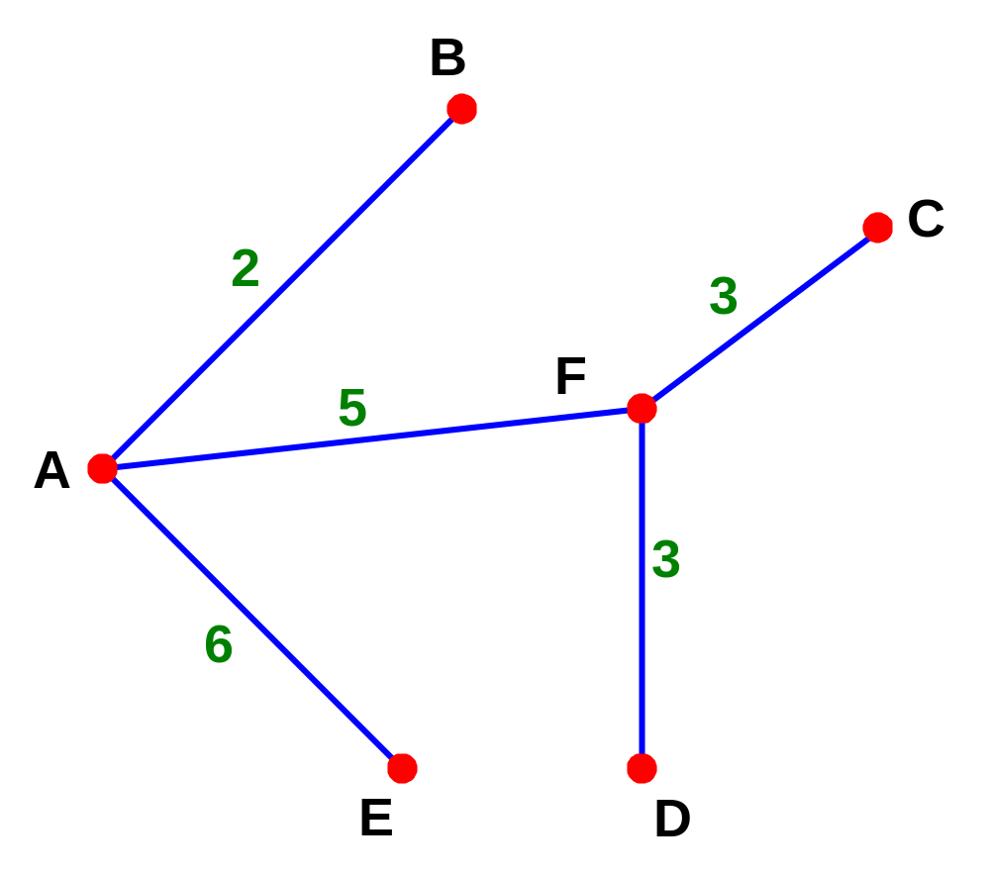
A spanning tree is a connected graph of all vertices which contains no cycles

Slide 5
The minimum spanning tree is the spanning tree with the least weight
Length of this tree is 19

Slide 6
The minimum spanning tree is the spanning tree with the least weight
Can you find the least weight?

Slide 7
The minimum spanning tree is the spanning tree with the least weight
The least weight is 15

Slide 8
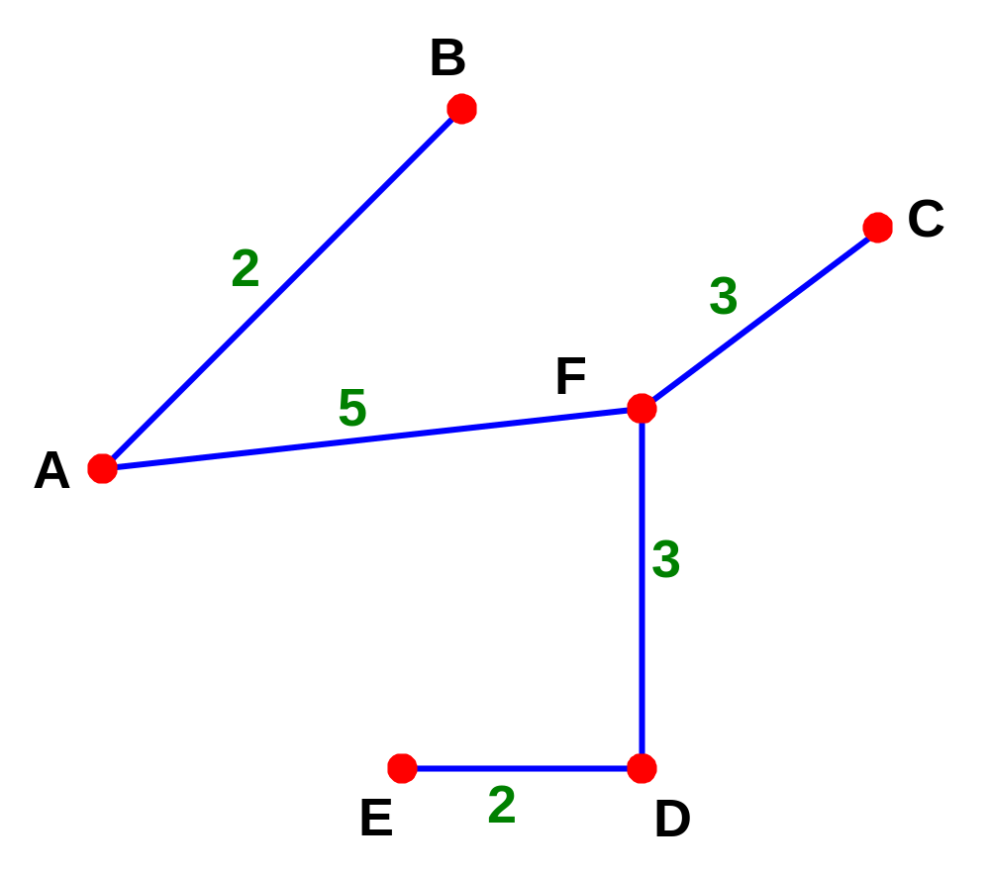
The minimum spanning tree is the spanning tree with the least weight
The least weight is 15

Slide 9
A tree (a connected graph with no cycles) which connects all the nodes together is called a Spanning Tree
For any connected graph with n nodes, each spanning tree will have n - 1 edges
A spanning tree whose total cost is minimum is known as Minimum Spanning Tree. The total cost is the sum of weights of edges of the tree.

Slide 10
More Notes
Prim’s Algorithm is a quick way of finding the Minimum Spanning Tree (or minimum connector)
This algorithm is said to be “greedy” since it picks the immediate best option available without taking into account the long-term consequences of the choices made.
Kruskal’s Algorithm may also be used to find a minimum spanning tree, but this considers the weights themselves rather than the connecting points

Slide 11
Algorithm Characteristics
Both Prim’s and Kruskal’s Algorithms work with undirected graphs
Both work with weighted and unweighted graphs but are more interesting when edges are weighted
Both are greedy algorithms that produce optimal solutions

Slide 12
Prim’s Algorithm
Similar to Dijkstra’s Algorithm except that d_{v} records edge weights, not path lengths

Slide 13
Walk-Through
2
Initialize array
F
3
C
 | K | d_{v} | p_{v}
A | F | ∞ | −
B | F | ∞ | −
C | F | ∞ | −
D | F | ∞ | −
E | F | ∞ | −
F | F | ∞ | −
G | F | ∞ | −
H | F | ∞ | −
10
A
7
3
8
4
4
B
18
D
9
10
H
2
25
3
G
E
7

Slide 14
2
Start with any node, say D
F
3
C
 | K | d_{v} | p_{v}
A
B
C
D | T | 0 | −
E
F
G
H
10
A
7
3
8
4
4
B
18
D
9
10
H
2
25
3
G
E
7

Slide 15
2
Update distances of adjacent, unselected nodes
F
3
C
 | K | d_{v} | p_{v}
A
B
C |  | 3 | D
D | T | 0 | −
E |  | 25 | D
F |  | 18 | D
G |  | 2 | D
H
10
A
7
3
8
4
4
B
18
D
9
10
H
2
25
3
G
E
7

Slide 16
2
Select node with minimum distance
F
3
C
 | K | d_{v} | p_{v}
A
B
C |  | 3 | D
D | T | 0 | −
E |  | 25 | D
F |  | 18 | D
G | T | 2 | D
H
10
A
7
3
8
4
4
B
18
D
9
10
H
2
25
3
G
E
7

Slide 17
2
Update distances of adjacent, unselected nodes
F
3
C
 | K | d_{v} | p_{v}
A
B
C |  | 3 | D
D | T | 0 | −
E |  | 7 | G
F |  | 18 | D
G | T | 2 | D
H |  | 3 | G
10
A
7
3
8
4
4
B
18
D
9
10
H
2
25
3
G
E
7

Slide 18
2
Select node with minimum distance
F
3
C
 | K | d_{v} | p_{v}
A
B
C | T | 3 | D
D | T | 0 | −
E |  | 7 | G
F |  | 18 | D
G | T | 2 | D
H |  | 3 | G
10
A
7
3
8
4
4
B
18
D
9
10
H
2
25
3
G
E
7

Slide 19
2
Update distances of adjacent, unselected nodes
F
3
C
 | K | d_{v} | p_{v}
A
B |  | 4 | C
C | T | 3 | D
D | T | 0 | −
E |  | 7 | G
F |  | 3 | C
G | T | 2 | D
H |  | 3 | G
10
A
7
3
8
4
4
B
18
D
9
10
H
2
25
3
G
E
7

Slide 20
2
Select node with minimum distance
F
3
C
 | K | d_{v} | p_{v}
A
B |  | 4 | C
C | T | 3 | D
D | T | 0 | −
E |  | 7 | G
F | T | 3 | C
G | T | 2 | D
H |  | 3 | G
10
A
7
3
8
4
4
B
18
D
9
10
H
2
25
3
G
E
7

Slide 21
2
Update distances of adjacent, unselected nodes
F
3
C
 | K | d_{v} | p_{v}
A |  | 10 | F
B |  | 4 | C
C | T | 3 | D
D | T | 0 | −
E |  | 2 | F
F | T | 3 | C
G | T | 2 | D
H |  | 3 | G
10
A
7
3
8
4
4
B
18
D
9
10
H
2
25
3
G
E
7

Slide 22
2
Select node with minimum distance
F
3
C
 | K | d_{v} | p_{v}
A |  | 10 | F
B |  | 4 | C
C | T | 3 | D
D | T | 0 | −
E | T | 2 | F
F | T | 3 | C
G | T | 2 | D
H |  | 3 | G
10
A
7
3
8
4
4
B
18
D
9
10
H
2
25
3
G
E
7

Slide 23
2
Update distances of adjacent, unselected nodes
F
3
C
 | K | d_{v} | p_{v}
A |  | 10 | F
B |  | 4 | C
C | T | 3 | D
D | T | 0 | −
E | T | 2 | F
F | T | 3 | C
G | T | 2 | D
H |  | 3 | G
10
A
7
3
8
4
4
B
18
D
9
10
H
2
25
3
G
E
7
Table entries unchanged

Slide 24
2
Select node with minimum distance
F
3
C
 | K | d_{v} | p_{v}
A |  | 10 | F
B |  | 4 | C
C | T | 3 | D
D | T | 0 | −
E | T | 2 | F
F | T | 3 | C
G | T | 2 | D
H | T | 3 | G
10
A
7
3
8
4
4
B
18
D
9
10
H
2
25
3
G
E
7

Slide 25
2
Update distances of adjacent, unselected nodes
F
3
C
 | K | d_{v} | p_{v}
A |  | 4 | H
B |  | 4 | C
C | T | 3 | D
D | T | 0 | −
E | T | 2 | F
F | T | 3 | C
G | T | 2 | D
H | T | 3 | G
10
A
7
3
8
4
4
B
18
D
9
10
H
2
25
3
G
E
7

Slide 26
2
Select node with minimum distance
F
3
C
 | K | d_{v} | p_{v}
A | T | 4 | H
B |  | 4 | C
C | T | 3 | D
D | T | 0 | −
E | T | 2 | F
F | T | 3 | C
G | T | 2 | D
H | T | 3 | G
10
A
7
3
8
4
4
B
18
D
9
10
H
2
25
3
G
E
7

Slide 27
2
Update distances of adjacent, unselected nodes
F
3
C
 | K | d_{v} | p_{v}
A | T | 4 | H
B |  | 4 | C
C | T | 3 | D
D | T | 0 | −
E | T | 2 | F
F | T | 3 | C
G | T | 2 | D
H | T | 3 | G
10
A
7
3
8
4
4
B
18
D
9
10
H
2
25
3
G
E
7
Table entries unchanged

Slide 28
2
Select node with minimum distance
F
3
C
 | K | d_{v} | p_{v}
A | T | 4 | H
B | T | 4 | C
C | T | 3 | D
D | T | 0 | −
E | T | 2 | F
F | T | 3 | C
G | T | 2 | D
H | T | 3 | G
10
A
7
3
8
4
4
B
18
D
9
10
H
2
25
3
G
E
7

Slide 29
2
Cost of Minimum Spanning Tree = Σ d_{v} = 21
F
3
C
 | K | d_{v} | p_{v}
A | T | 4 | H
B | T | 4 | C
C | T | 3 | D
D | T | 0 | −
E | T | 2 | F
F | T | 3 | C
G | T | 2 | D
H | T | 3 | G
A
3
4
4
B
D
H
2
3
G
E
Done

Slide 30
Prim’s Algorithm
Using Prim’s Algorithm, the minimal spanning tree is built edge by edge. First an edge with minimum weight is selected and included in Minimal spanning Tree(MST). The next edges are chosen and included in such a way that there will only be a minimum increase in the total cost. Each time when an edge is selected, it must be checked that it does not form a loop or cycle.

Slide 31
Prim’s Algorithm
Aim: To find a minimum spanning tree T
Step 1: Find the edge with minimum weight and add it to the minimum spanning tree. Let the edge be (U,V).
Step 2:Find the edges from U and V, select the edge with minimum cost among these edges.
i. If an addition of this edge in Minimal Spanning Tree leads to a cycle then select the next minimal edge and add it to the Minimal Spanning Tree.
ii. Otherwise, add the selected edge to Minimal Spanning Tree.
Step 3: Repeat Step 2 until (n-1) edges are included in Minimum Spanning Tree(T).

Slide 32
Algorithm Prim(C,n)
{
//Assume G is connected, undirected graph
//C is the cost adjacency matrix
// n- number of vertices
//T-Minimum weight Spanning Tree
for(i=1;i<=n;i++)

Slide 33
Visited[i]=0
// initialize all vertices as unvisited
//consider vertex 1 as starting
u=1;
Visited[u]=1;
While(there is still un chosen vertex) do
{
Let<u,v> be the lightest edge between any

Slide 34
Chosen u to any un chosen vertex v.
Visited[v]=1;
T=Union(T,<u,v>);
//add edge to spanning tree
}
}

Slide 35
Kruskal’s Algorithm
Aim: To find a minimum spanning tree, the weights of edges are arranged in increasing order and following procedure is used:
Step 1:Select an edge with minimum weight and add it to spanning tree T. This is the first edge which has been added. Delete this edge from edge list.
Step 2: Repeat Step 3 until T has n – 1 edges.
Step 3:Add an edge with minimum weight from left over edges to spanning tree which does not form a cycle and delete this edge from edge list.

Slide 36
Kruskal’s Algorithm
Work with edges, rather than nodes
Two steps:
  Sort edges by increasing edge weight
  Select the first |V| – 1 edges that do not generate a cycle

Slide 37
Walk-Through
Consider an undirected, weight graph
F
3
C
10
A
4
3
8
4
5
B
6
D
4
4
H
2
1
3
G
E
3

Slide 38
Sort the edges by increasing edge weight
F
3
C
edge | d_{v}
(D,E) | 1
(D,G) | 2
(E,G) | 3
(C,D) | 3
(G,H) | 3
(C,F) | 3
(B,C) | 4
edge | d_{v}
(B,E) | 4
(B,F) | 4
(B,H) | 4
(A,H) | 5
(D,F) | 6
(A,B) | 8
(A,F) | 10
10
A
4
3
8
4
5
B
6
D
4
4
H
2
1
3
G
E
3

Slide 39
Select first |V|–1 edges which do not generate a cycle
F
3
C
edge | d_{v}
(D,E) | 1 | √
(D,G) | 2
(E,G) | 3
(C,D) | 3
(G,H) | 3
(C,F) | 3
(B,C) | 4
edge | d_{v}
(B,E) | 4
(B,F) | 4
(B,H) | 4
(A,H) | 5
(D,F) | 6
(A,B) | 8
(A,F) | 10
10
A
4
3
8
4
5
B
6
D
4
4
H
2
1
3
G
E
3

Slide 40
Select first |V|–1 edges which do not generate a cycle
F
3
C
edge | d_{v}
(D,E) | 1 | √
(D,G) | 2 | √
(E,G) | 3
(C,D) | 3
(G,H) | 3
(C,F) | 3
(B,C) | 4
edge | d_{v}
(B,E) | 4
(B,F) | 4
(B,H) | 4
(A,H) | 5
(D,F) | 6
(A,B) | 8
(A,F) | 10
10
A
4
3
8
4
5
B
6
D
4
4
H
2
1
3
G
E
3

Slide 41
Select first |V|–1 edges which do not generate a cycle
F
3
C
edge | d_{v}
(D,E) | 1 | √
(D,G) | 2 | √
(E,G) | 3 | χ
(C,D) | 3
(G,H) | 3
(C,F) | 3
(B,C) | 4
edge | d_{v}
(B,E) | 4
(B,F) | 4
(B,H) | 4
(A,H) | 5
(D,F) | 6
(A,B) | 8
(A,F) | 10
10
A
4
3
8
4
5
B
6
D
4
4
H
2
1
3
G
E
3
Accepting edge (E,G) would create a cycle

Slide 42
Select first |V|–1 edges which do not generate a cycle
F
3
C
edge | d_{v}
(D,E) | 1 | √
(D,G) | 2 | √
(E,G) | 3 | χ
(C,D) | 3 | √
(G,H) | 3
(C,F) | 3
(B,C) | 4
edge | d_{v}
(B,E) | 4
(B,F) | 4
(B,H) | 4
(A,H) | 5
(D,F) | 6
(A,B) | 8
(A,F) | 10
10
A
4
3
8
4
5
B
6
D
4
4
H
2
1
3
G
E
3

Slide 43
Select first |V|–1 edges which do not generate a cycle
F
3
C
edge | d_{v}
(D,E) | 1 | √
(D,G) | 2 | √
(E,G) | 3 | χ
(C,D) | 3 | √
(G,H) | 3 | √
(C,F) | 3
(B,C) | 4
edge | d_{v}
(B,E) | 4
(B,F) | 4
(B,H) | 4
(A,H) | 5
(D,F) | 6
(A,B) | 8
(A,F) | 10
10
A
4
3
8
4
5
B
6
D
4
4
H
2
1
3
G
E
3

Slide 44
Select first |V|–1 edges which do not generate a cycle
F
3
C
edge | d_{v}
(D,E) | 1 | √
(D,G) | 2 | √
(E,G) | 3 | χ
(C,D) | 3 | √
(G,H) | 3 | √
(C,F) | 3 | √
(B,C) | 4
edge | d_{v}
(B,E) | 4
(B,F) | 4
(B,H) | 4
(A,H) | 5
(D,F) | 6
(A,B) | 8
(A,F) | 10
10
A
4
3
8
4
5
B
6
D
4
4
H
2
1
3
G
E
3

Slide 45
Select first |V|–1 edges which do not generate a cycle
F
3
C
edge | d_{v}
(D,E) | 1 | √
(D,G) | 2 | √
(E,G) | 3 | χ
(C,D) | 3 | √
(G,H) | 3 | √
(C,F) | 3 | √
(B,C) | 4 | √
edge | d_{v}
(B,E) | 4
(B,F) | 4
(B,H) | 4
(A,H) | 5
(D,F) | 6
(A,B) | 8
(A,F) | 10
10
A
4
3
8
4
5
B
6
D
4
4
H
2
1
3
G
E
3

Slide 46
Select first |V|–1 edges which do not generate a cycle
F
3
C
edge | d_{v}
(D,E) | 1 | √
(D,G) | 2 | √
(E,G) | 3 | χ
(C,D) | 3 | √
(G,H) | 3 | √
(C,F) | 3 | √
(B,C) | 4 | √
edge | d_{v}
(B,E) | 4 | χ
(B,F) | 4
(B,H) | 4
(A,H) | 5
(D,F) | 6
(A,B) | 8
(A,F) | 10
10
A
4
3
8
4
5
B
6
D
4
4
H
2
1
3
G
E
3

Slide 47
Select first |V|–1 edges which do not generate a cycle
F
3
C
edge | d_{v}
(D,E) | 1 | √
(D,G) | 2 | √
(E,G) | 3 | χ
(C,D) | 3 | √
(G,H) | 3 | √
(C,F) | 3 | √
(B,C) | 4 | √
edge | d_{v}
(B,E) | 4 | χ
(B,F) | 4 | χ
(B,H) | 4
(A,H) | 5
(D,F) | 6
(A,B) | 8
(A,F) | 10
10
A
4
3
8
4
5
B
6
D
4
4
H
2
1
3
G
E
3

Slide 48
Select first |V|–1 edges which do not generate a cycle
F
3
C
edge | d_{v}
(D,E) | 1 | √
(D,G) | 2 | √
(E,G) | 3 | χ
(C,D) | 3 | √
(G,H) | 3 | √
(C,F) | 3 | √
(B,C) | 4 | √
edge | d_{v}
(B,E) | 4 | χ
(B,F) | 4 | χ
(B,H) | 4 | χ
(A,H) | 5
(D,F) | 6
(A,B) | 8
(A,F) | 10
10
A
4
3
8
4
5
B
6
D
4
4
H
2
1
3
G
E
3

Slide 49
Select first |V|–1 edges which do not generate a cycle
F
3
C
edge | d_{v}
(D,E) | 1 | √
(D,G) | 2 | √
(E,G) | 3 | χ
(C,D) | 3 | √
(G,H) | 3 | √
(C,F) | 3 | √
(B,C) | 4 | √
edge | d_{v}
(B,E) | 4 | χ
(B,F) | 4 | χ
(B,H) | 4 | χ
(A,H) | 5 | √
(D,F) | 6
(A,B) | 8
(A,F) | 10
10
A
4
3
8
4
5
B
6
D
4
4
H
2
1
3
G
E
3

Slide 50
Select first |V|–1 edges which do not generate a cycle
F
3
C
edge | d_{v}
(D,E) | 1 | √
(D,G) | 2 | √
(E,G) | 3 | χ
(C,D) | 3 | √
(G,H) | 3 | √
(C,F) | 3 | √
(B,C) | 4 | √
edge | d_{v}
(B,E) | 4 | χ
(B,F) | 4 | χ
(B,H) | 4 | χ
(A,H) | 5 | √
(D,F) | 6
(A,B) | 8
(A,F) | 10
A
3
4
5
B
D
H
2
1
}
3
G
E
not
considered
Done
Total Cost = Σ d_{v} = 21

